Slide 1

Infomineo presentation

Slide 2
Infomineo provides global research coverage
Infomineo is a Brainshoring company
Founded in 2011 by two former consultants
Through the research provided, we help our clients:
Focus on their core capabilities
Make well educated business decisions
Geographic presence
Geographic distribution of our work: 40% Europe, 40% Middle East and Africa, 20% ROW

Slide 3































Infomineo, the leader in Brainshoring
250 employees, 55% of women Mix of business and technical (engineering, design) backgrounds
200,000+ requests successfully executed
90% of our business on a retainer basis
25 nationalities, 18 languages spoken natively
5 offices Casablanca, Cairo, Mexico, Dubai and Barcelona
Geographic distribution of our work: 40% Europe, 40% Middle East and Africa, 20% ROW
Clients
All the leading consultancies and 50+ of the Fortune 500 companies

Slide 4

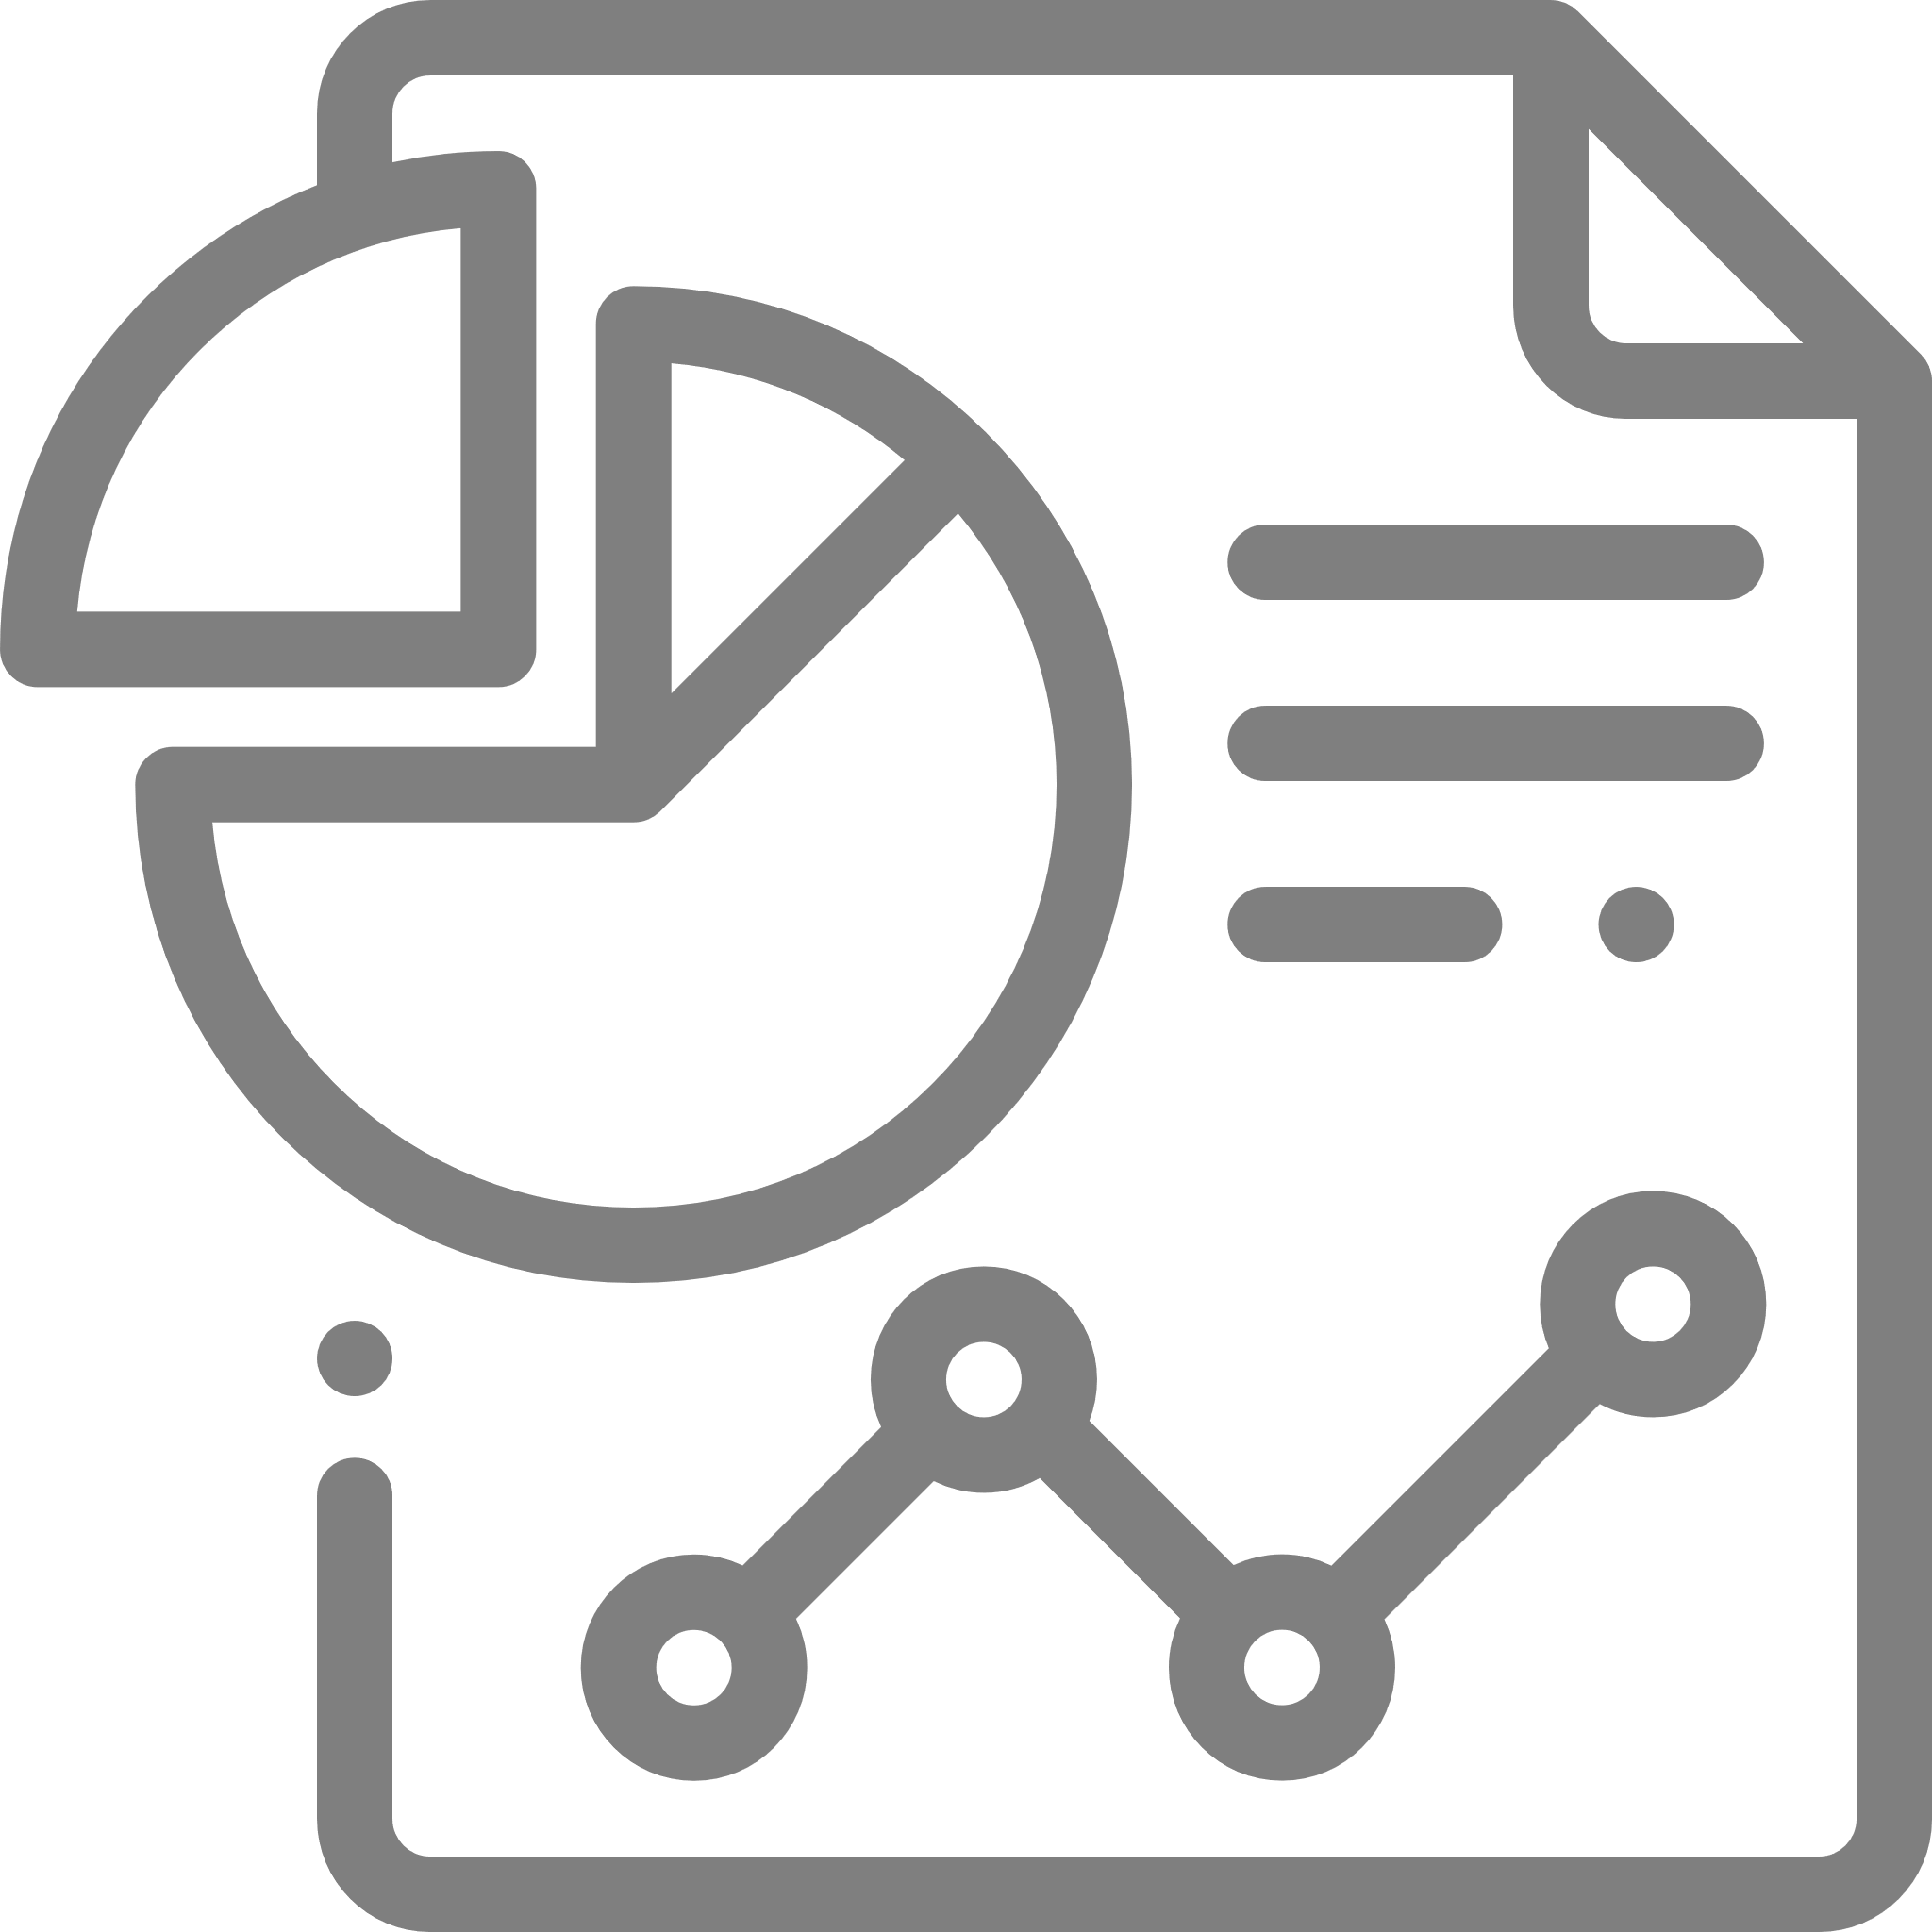





Infomineo offers a suite of Brainshoring services
Data research
Getting the right insights to make better decisions
Desk research
Getting insights through free and paid data sources
Graphic design
Primary research
Building new data through interviews (cold calling or Expert Interviews), or field work
“Brainshoring”
Presenting messages in a meaningful and beautiful way
The business of offshoring tasks that require extensive communication and critical thinking/problem solving skills
Language services
Tech enabled research
Using technology to generate data and insights
Translating business content between languages without betraying the original message, and advising on language related issues
Data Analytics
Analyzing data to extract relevant insights and identify trends to answer business questions

Slide 5
Data Research

Slide 6

Infomineo offers a complete range of Research services
Research
Four Levels of Research
Combination of Approaches
Three Types of Support
Country selection, demographics, economy, doing business etc.
Open sources and paid sources such as Orbis, Capital IQ and Factiva
Answering research requests to support project execution, proposal development or internal discussions
Country
Via online surveys, cold calling, and Expert interviews
Ad-hoc
Market sizing, competitive landscaping, road to market/value chain mapping etc.
Market
Desk research
Primary research
Preparing newsletters, regular benchmarking, tracking competitive moves etc.
Company financials, company profiling, supplier/client identification etc.
Tracking
Company
Tech enabled research
Performing online surveys, getting insights from social listening, organising expert interviews
Database creation, thought leadership
Consumer/ Expert
Social listening, web scraping
Content development

Slide 7






Some databases and tools we subscribe to
Database
Functionalities
Use cases examples
Qualitative and quantitative information on public and private companies
Generating a list of companies based on criteria (eg: location, industry, size)
Generating a list of transactions (M&A or other forms) based on the same criteria
Creating advanced excel models using proprietary formulas
Top XX companies in YY industry
List of IPOs in a specific timeframe and industry
High level company profile of 10 players
CEOs change in S&P 500 companies in the last xx years
TSR and stock data for a list of companies
Qualitative and quantitative information on public and private companies
Generating a list of companies based on criteria (eg: location, industry, size)
Top XX companies in YY industry
Financial ratios for a list of companies
Batch search for 100+ companies
Press search based on advanced and proprietary Boolean operators
News alerts on companies/ industries
Access to premium and sectorial press sources (eg: FT)
Weekly newsletter on XX industry
Key developments of a company in the past xx years
Market trends and analysis
Social listening
Evaluating brands
Market data and prices
Company data (including investment research)
M&A transactions
Projects data in MEA region
List of projects in specific industries with their projects value
Analyst reports on public companies
Market and consumer data on 80 000 topics
Consumer trends
Market drivers

Slide 8
Data Analytics

Slide 9
Infomineo has a unique approach to Data Analytics
Analytics
Traditional model
Infomineo model
Most Data analytics companies provide standard models that they transpose from a client to another
Often Data analytics companies provides models that stay in the state of Proof-Of-Concept because integration with IT teams is not complete
Most Data analytics providers are specialized in Visualization tools : Tableau, Power Bi etc.
Most providers work on a project basis – The models are afterwards difficult to maintain over time by the clients' teams
The providers retain rights on the Intellectual property they generate
We are problem solvers, we need to understand your question or challenge and will find the data & models which answers your question
We have a multi capabilities team that can provide you an end-to-end approach from cleaning the data to visualizing the model output
We work on a retainer basis, we are an extension of your team, and make it easy to work with us, which 1/minimizes the time you spend on paperwork and 2/allows you to work with us on an iterative basis
The output is co-constructed with our client and not a model taken off the shelf

Slide 10
Infomineo offers a full suite of Data Analytics Services
Analytics
Three Levels of Analytics
Business Oriented Approach
Three Types of Support
Data Exploration & Cleaning
Data Visualization : reports, automated dashboards
Gathering Data from various storage, Assessing Data Quality and processing cleaning and wrangling
Data Analysis
Infomineo’s teams demonstrate a high Business sense
We work in an iterative approach to fulfill clients needs quickly
Data Preparation
Statistical Analysis
Model building & tuning
Model evaluation & retraining
Business & Data Understanding
Agile Methodology
Data
Science
Interactive Visualization
Building and maintaining self service analytics
Delivery Management
Feature Engineering : Data wrangling, Data transformation
Model Deployment & scalability
Building predictive and prescriptive models & possibility to deploy to production
Data Engineering
Release & Change Management are handled: versioning, unit tests, model validation, code reviews, documentation…
Modeling

Slide 11






Our approach to helping you
Analytics
Intake
Execution
Delivery
Understanding client needs and objective
Get a deep understanding of the client objectives:
Type of analytics support considered
Business questions to answer
Assess available data, data needs if any, critical data elements to take care of
Planned use of the analytics outputs
Structuring approach
Define the best data analytics strategy to answer the client’s business objective
Estimate the time needed
Define the type of output needed
Executing Analytics
Leveraging a full range of analytics capabilities
Data Preparation
Identifying Data Sources
Extracting & Transferring Data
Metadata & Dictionaries
Merging of various data sources & adding new data
Assessing Data Quality
Handling Outliers
Restructuring Data for analysis
Making features extractions
Business & Data Under
standing
Agile Metho
dology
Data Modeling
Build algorithms to answer the business question (binary classification, segmentation, forecasting …)
Evaluation and validation of the algorithm
Deriving insights
Performing in-depth quality assurance
Analyzing the data outputs to derive insights in line with the initial client ask
Handover
Presenting the approach, results and potential limitations
Sharing all the documentation & codes
Getting client feedback
Definining scaling with clients’ IT Teams (to be scheduled if any)
Performing regular model maintenance (to be scheduled if any)
Delivery Management
Exploratory Analysis
Descriptive analysis
Data visualization
KPIs
Data story telling

Slide 12
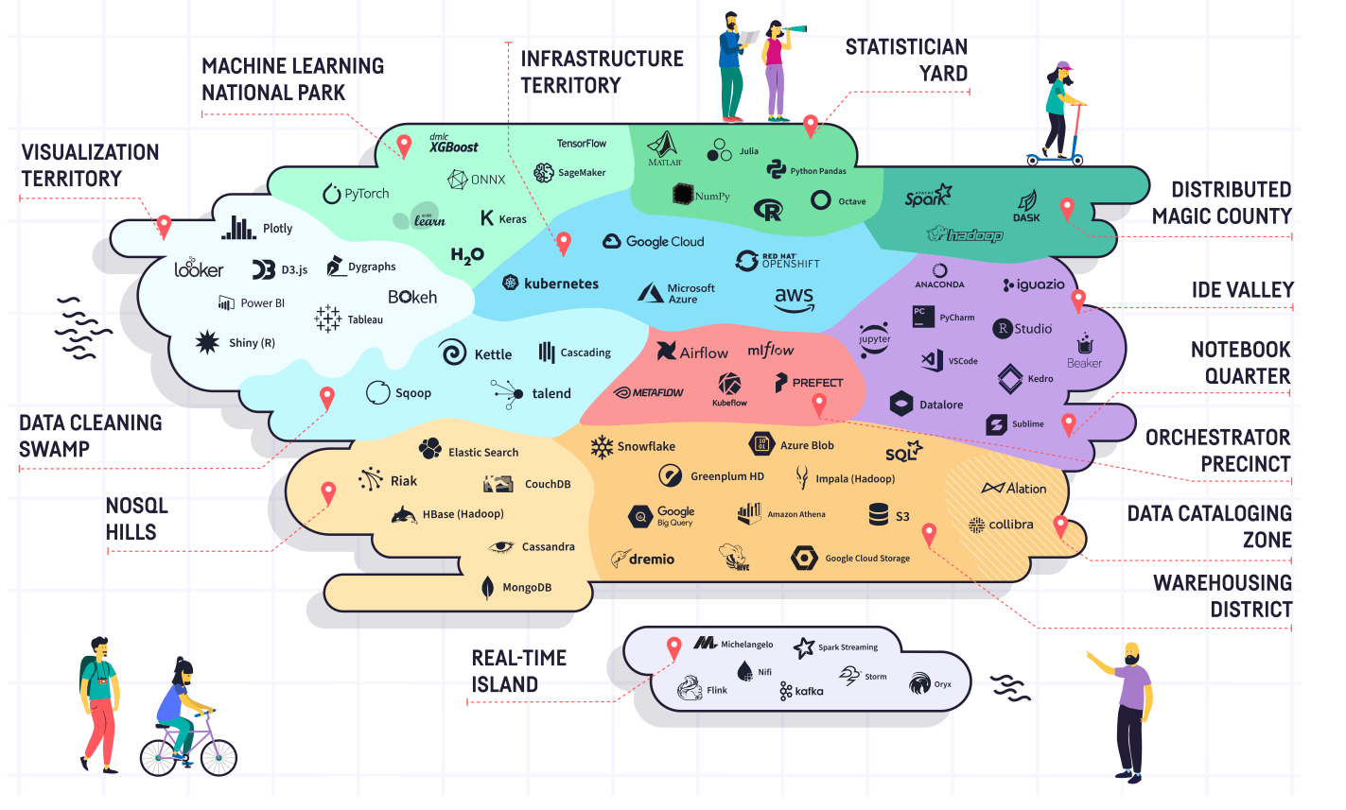

Technologies Infomineo can handle
Capabilities we already have
Capabilities we are building

Slide 13
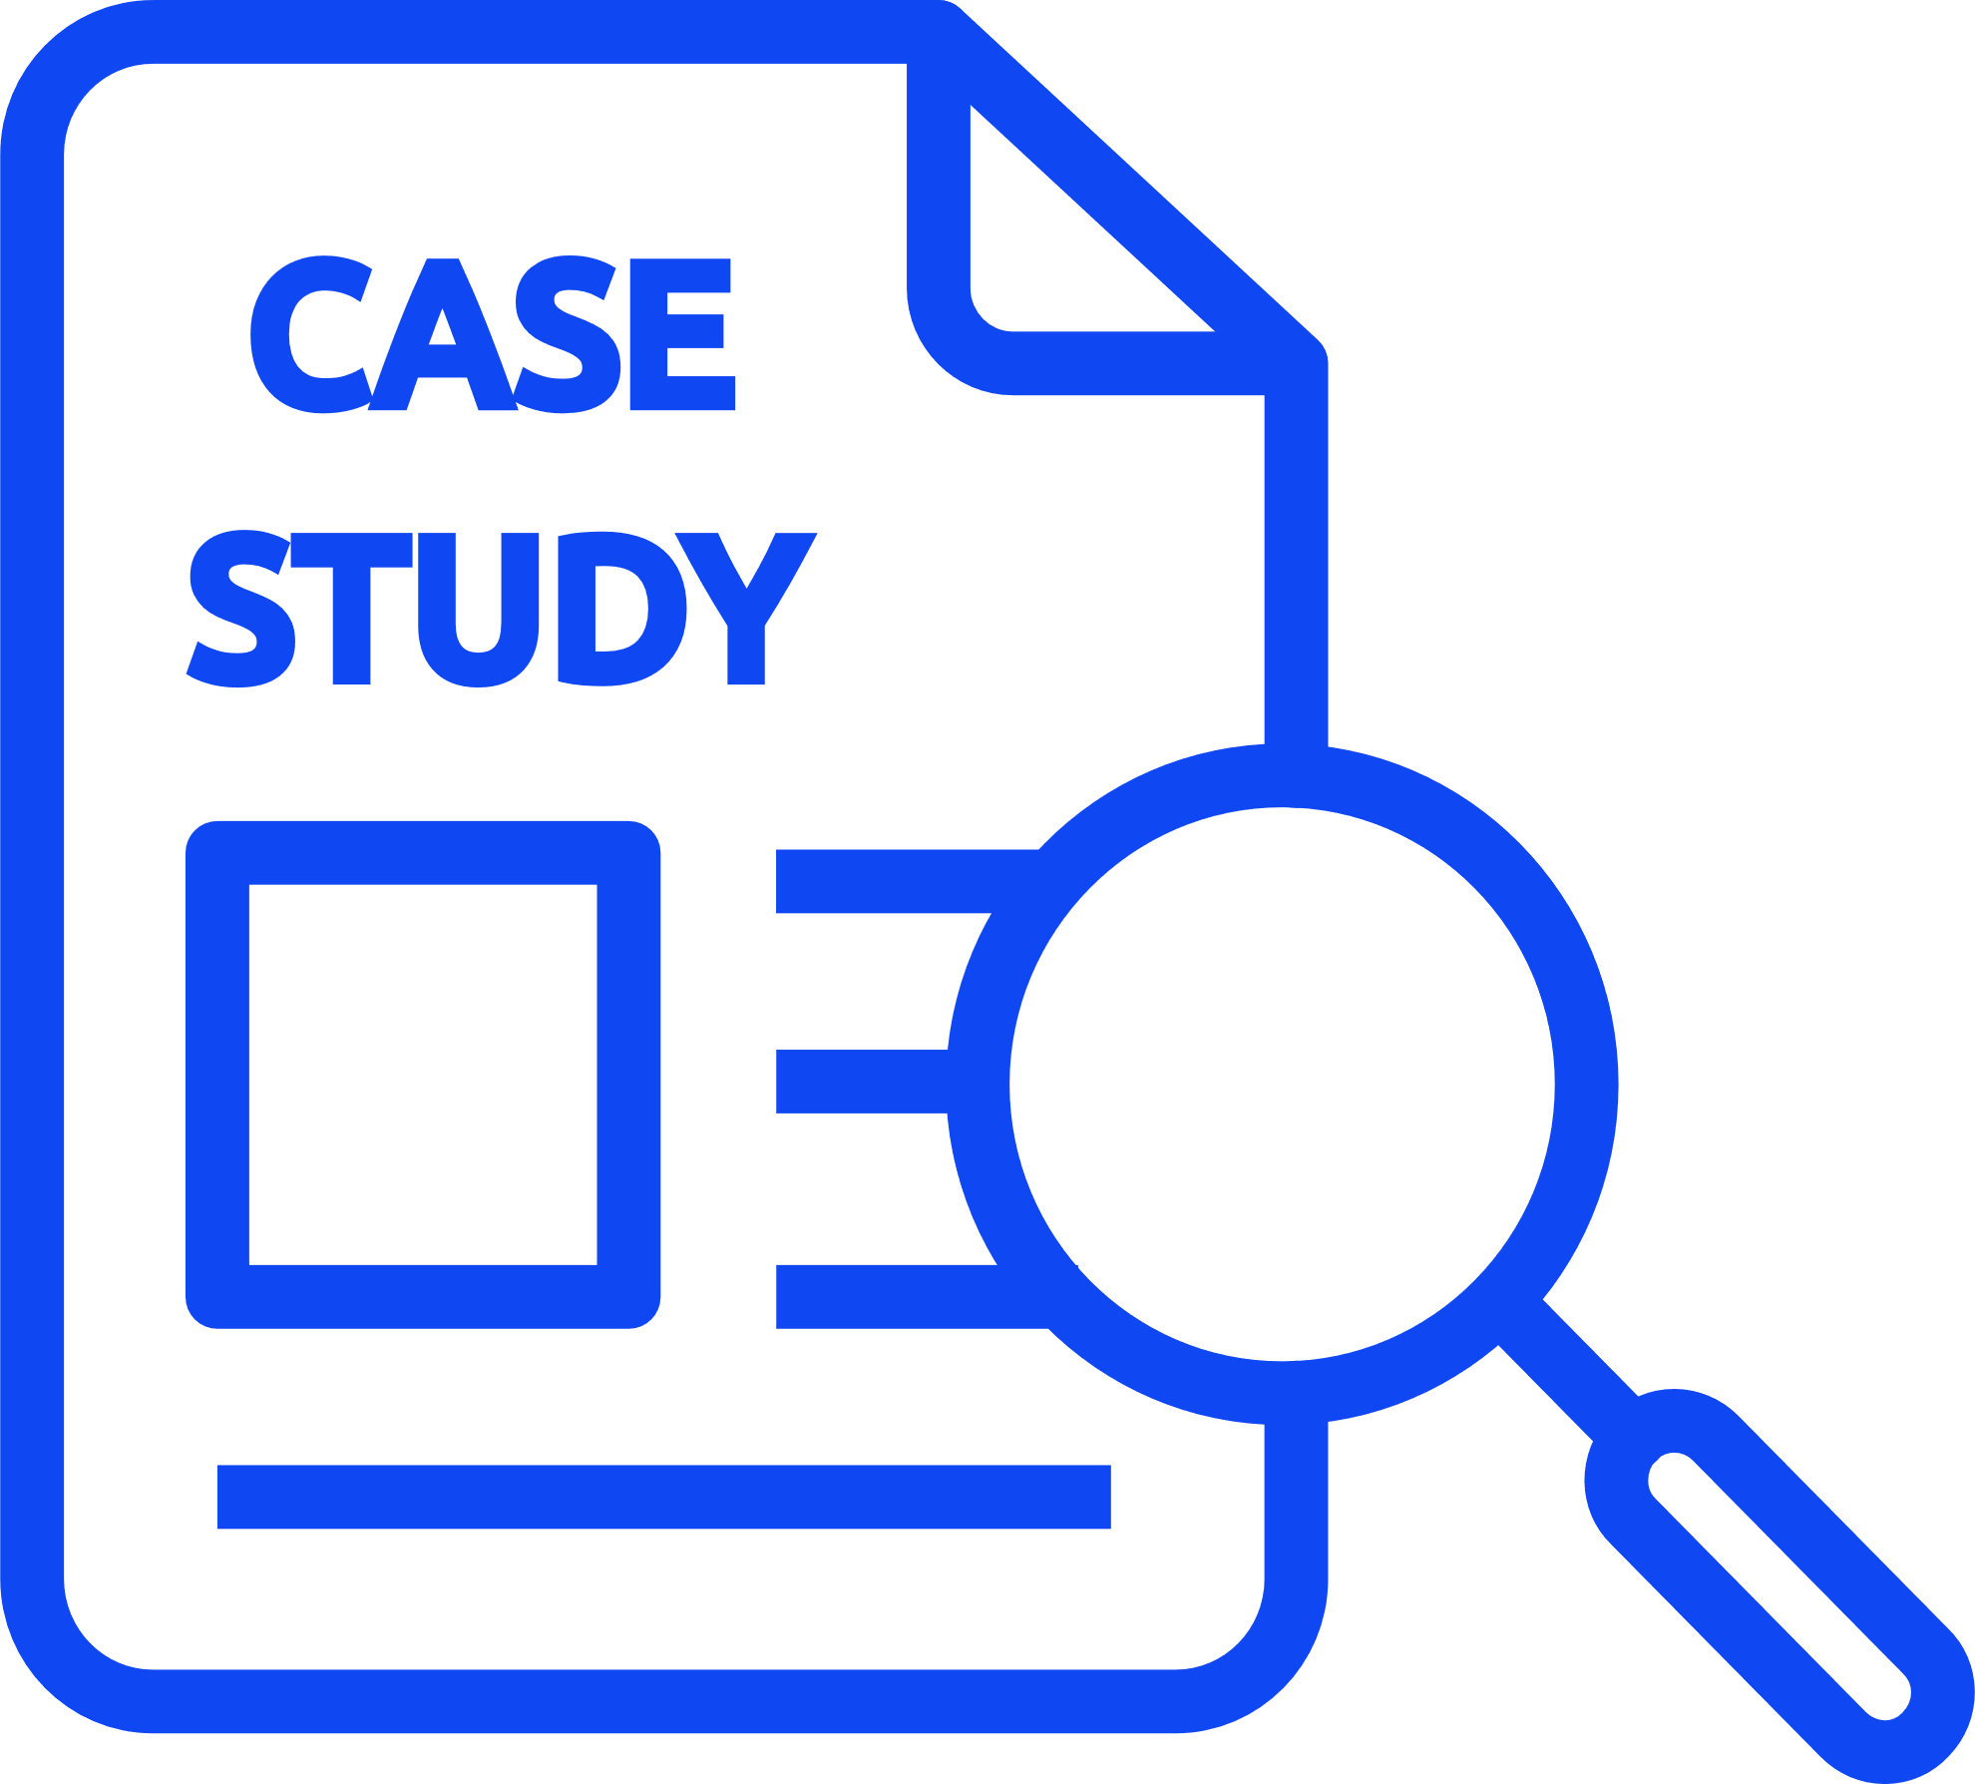


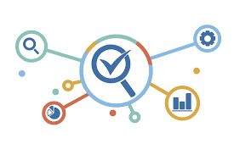





CASE STUDY
Client Challenge
Our Solution
Outcome
Client:
The client wants to have an automatized Human Resource Dashboard to track, analyze and report on HR KPIs.
The firm was looking for:
The company decided to use Infomineo’s Data Analytics service as a solution to cover:
The firm recognized that the quality of the Data Analytics service provided a useful reporting tool resulting in:
A multinational firm
Data Quality & Consistency problems between the various Data sources
Dashboard creation that reflects HR Team needs
During the project, Data were corrected in the ERPs :
Manual files where not used anymore
Data Quality improved by 55% for critical data elements
Effective and quick solution
“I was really impressed by the responsiveness of the team : they came up with a first and quite impressive dashboard proposition within only a couple of days. I also really appreciated the quality of the work; it was really helpful for us to identify the data cleansing needed in our ERP.”
─ Chief Human Capital Officer (Client)
Estimated 1 FTE from the HR department could be reallocated to other tasks
Helped the company to start its Data Transformation
Infomineo has been asked to work with client’s Finance Team to create another dashboard
Smooth integration with its existing ERPs
Lower cost than buying from a specialized company an HR Dashboard tool
Ad-hoc deliverables :
Dictionaries, Creation of Metadata, Data Quality On boarding

